Slide 1
PHP

Slide 2
Outline
What is Server-Side programming
Comparison of Server-Side technologies
PHP

Slide 3
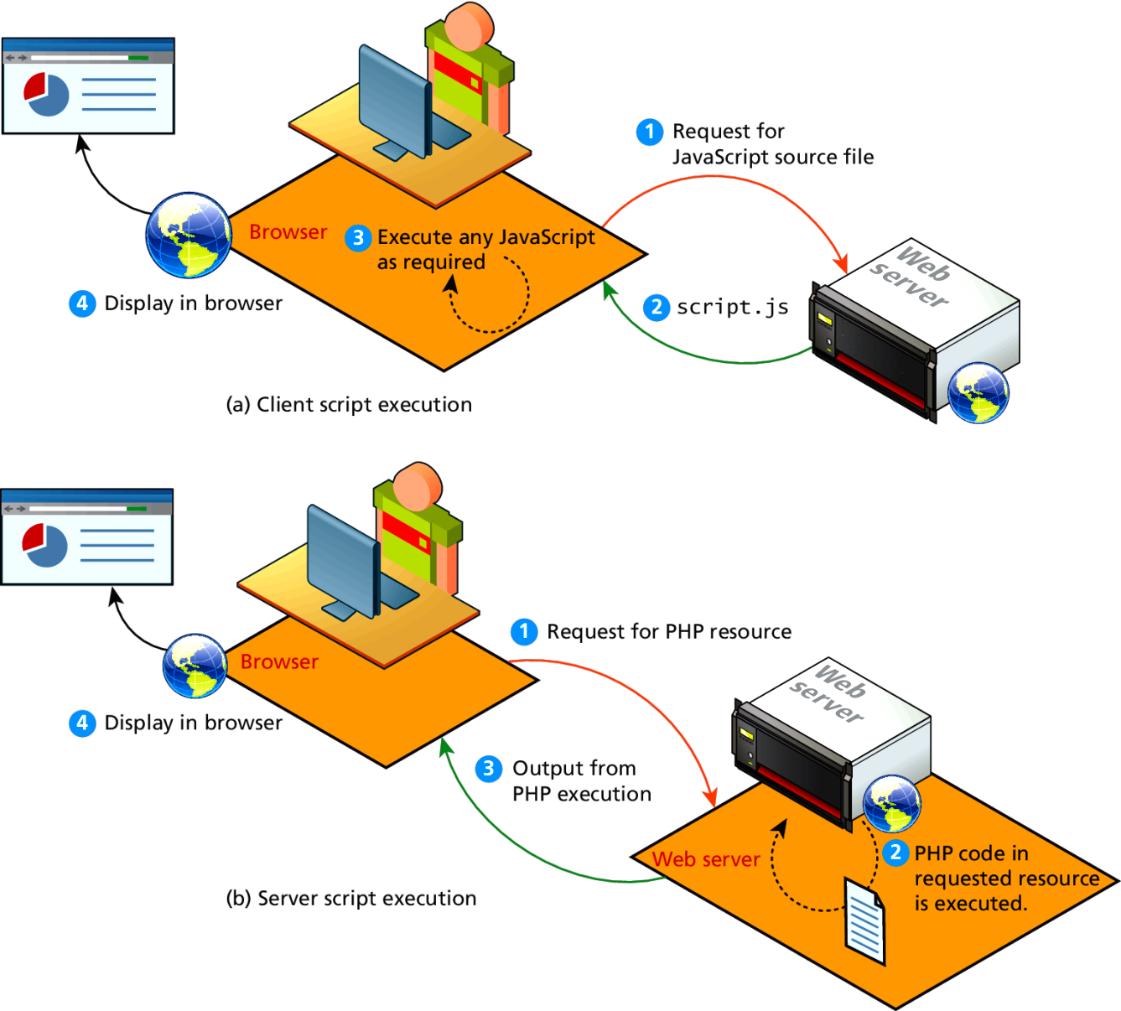
A Web Server’s Responsibilities
A web server has many responsibilities:
handling HTTP connections
responding to requests for static and dynamic resources
managing permissions and access for certain resources
encrypting and compressing data
managing multiple domains and URLs
managing database connections
managing cookies and state
uploading and managing files

Slide 4
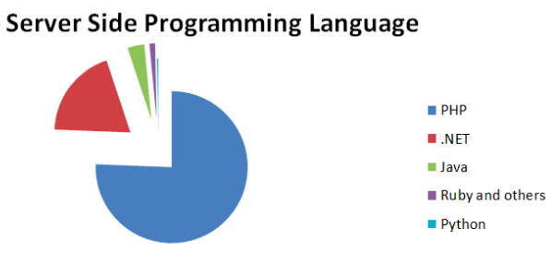
Server-Side Technology
PHP
JSP
ASP.NET
Python
Ruby on Rails

Slide 5
Comparing Server-Side Technologies
ASP.NET (Active Server Pages . NET)
Is part of Microsoft’s .NET Framework and uses C# programming lang.
Its compiled into intermediate file format MSIL (similar to Java bytecode). ASP.NET then uses a Just-In-Time compiler to compile the MSIL into machine executable code so its performance can be excellent.
But its limited to Window servers
JSP (Java Server Pages)
JSP uses Java as its programming language.
JSP uses the Java Runtime Engine, and also uses a JIT compiler for fast execution time and is cross-platform. While JSP’s usage in the web as a whole is small, it has a substantial market share in the intranet environment, as well as with very large and busy sites.

Slide 6
Comparing Server-Side Technologies
Node.js
Recent server environment that uses JavaScript on the server side.
Unlike the other tools, node.js also is its own web server software, thus eliminating the need for Apache, IIS, or some other web server software.
PHP
PHP is a dynamically typed language that can be embedded directly within the HTML, though it now supports most common object-oriented features, such as classes and inheritance.
PHP pages are compiled into an intermediary representation called opcodes.

Slide 7
Comparing Server-Side Technologies
Python
Simple but powerful object-oriented programming language.
It is also used in a variety of web development frameworks such as Django and Pyramid.
Ruby on Rails
This is a web development framework that uses the Ruby programming language.
Perl
Before PHP, Python, JSP, etc. Perl was the language typically used for early server-side web development.
As a language, it excels in the manipulation of text.
It was commonly used in conjunction with the Common Gateway Interface (CGI), an early standard API for communication between applications and web server software.

Slide 8
PHP (Hypertext Processor)
PHP is a open-source widely used server-side scripting language
PHP file can contain text, HTML, CSS, JavaScript, and PHP code
PHP code are preprocessed by a PHP interpreter on the server
Server sends the resulting output (web page as plain HTML) of the interpreter to a client
The client (a Web browser) then renders the page and displays for the user
PHP files have extension “.php”

Slide 9
What can PHP do?
PHP can generate dynamic page content
PHP can create, open, read, write, delete, and close files on the server
PHP can collect form data
PHP can send and receive cookies
PHP can add, delete, modify data in your database
PHP can be used to control user-access
PHP can encrypt data
With PHP you are not limited to output HTML. You can output images, PDF files, and even Flash movies. You can also output any text, such as XHTML and XML.

Slide 10
Why PHP?
PHP runs on various platforms (Windows, Linux, Mac OS X, etc.)
PHP is compatible with almost all servers used today.
PHP supports a wide range of databases
Download it free from the official PHP resource: www.php.net
PHP is easy to learn and runs efficiently on the server side
Some big guys use it: Facebook
It is powerful enough to be at the core of the biggest blogging system on the web (WordPress)!

Slide 11
LAMP stack
You will be using the LAMP software stack
Linux operating system
Apache web server
MySQL DBMS
PHP scripting language

Slide 12
Installing LAMP locally
The easiest and quickest way to do so is to use the
XAMPP For Windows installation package
Tutorial : https://blog.udemy.com/xampp-tutorial/
MAMP for Mac installation package
Tutorial: https://codex.wordpress.org/Installing_WordPress_Locally_on_Your_Mac_With_MAMP
Both of these installation packages install and configure Apache, PHP, and MySQL.
Later we can come back and configure these systems in more detail.

Slide 13
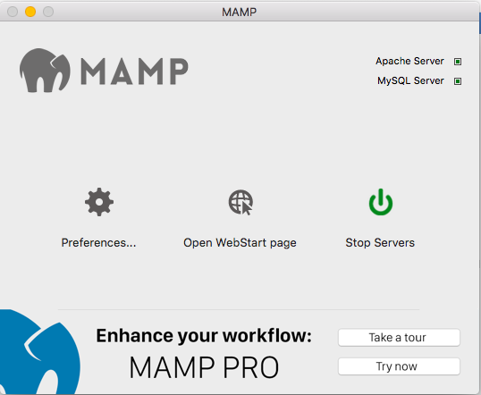
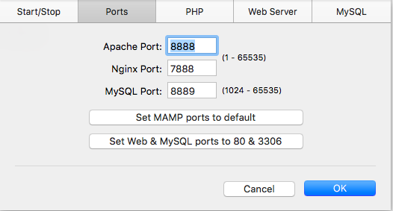
MAMP
You can start and stop web servers
From ’Preferences’ you can configure ports for Apache server and MySQL server.

Slide 14
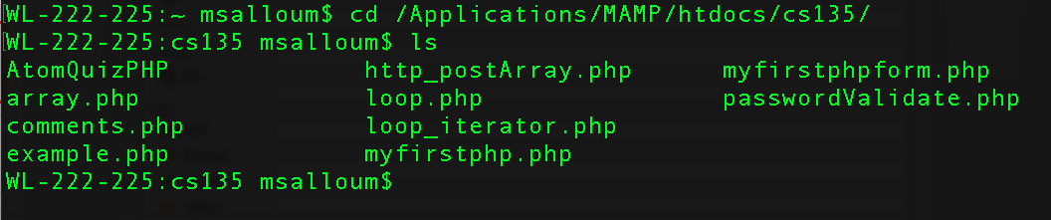
MAMP
On my mac, the MAMP tool was installed under /Applications/MAMP/htdocs
Move your php files to the that directory to view them.

Slide 15
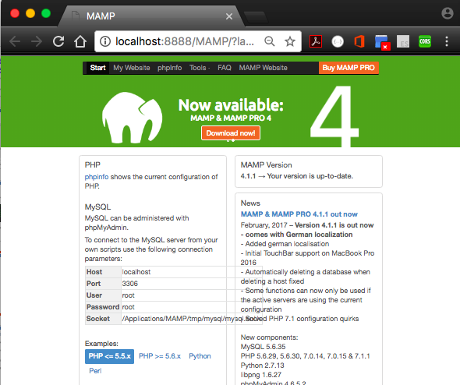
MAMP
We can navigate to appropriate port to view admin webpage:
http://localhost:8888/MAMP/?language=English

Slide 16
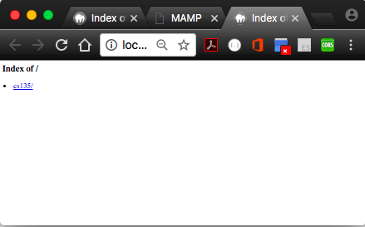
MAMP
Navigating to http://localhost:8888/
directs you to the folder with all your PHP examples.

Slide 17
Quick Overview of PHP
PHP, like JavaScript, is a dynamically typed language.
It uses classes and functions in a way consistent with other object-oriented languages such as C++, C#, and Java…...yey!!!
The syntax for loops, conditionals, and assignment is identical to JavaScript.
Differs when you get to functions, classes, and in how you define variables.

Slide 18
PHP Tags
The most important fact about PHP is that the programming code can be embedded directly within an HTML file.
A PHP file will usually have the extension .php
Code is contained within an opening tag <?php tag and a matching closing ?> tag
Any code outside the tags is echoed directly out to the client

Slide 19
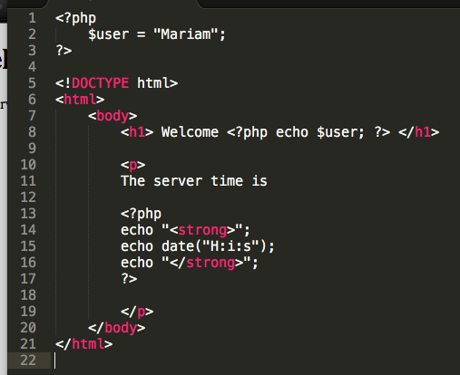
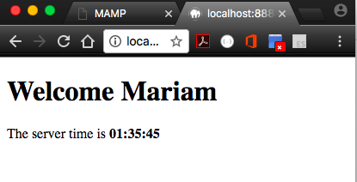
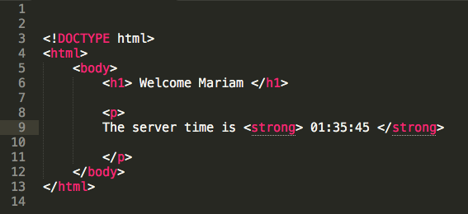
Lets look at an example
example.php
PHP code can be imbedded within HTML tags.
PHP code is interpreted and executed, while other code is echoed directly out to the client.
Hence when client requests example.php, the server interprets any PHP code, echo back rest of code to send pure HTML to client.

Slide 20
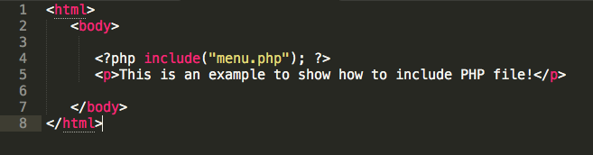
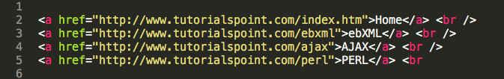
HTML and PHP
While its allowed to interleave HTML and PHP together, its best if we separate the the design from the logic of the code.
phpInclude.php
menu.php

Slide 21
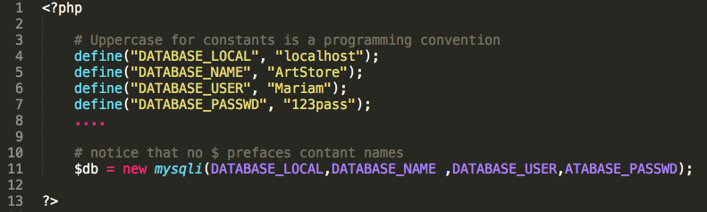
Variables in PHP are dynamically typed.
To declare a variable you must preface the variable name with the dollar ($) symbol.
A constant is similar to a variable, except its value never changes
Typically defined near the top of a PHP file via the define() function
Once it is defined, it can be referenced without using the $ symbol
$count = 42;

Slide 22
Data Types
Data Type | Description
Boolean | A logical true or false value
Integer | Whole numbers
Float | Decimal numbers
String | Letters
Array | A collection of data of any type (covered in the next chapter)
Object | Instances of classes

Slide 23
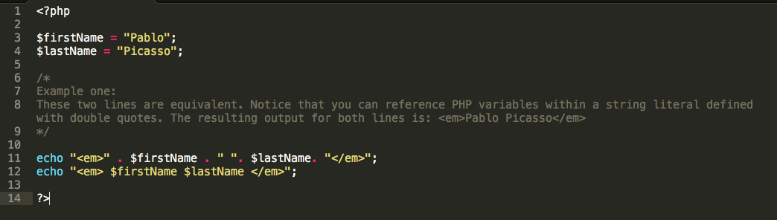
String Concatenation
Strings can easily be appended together using the concatenate operator, which is the period (.) symbol.
Note, to write to output, use “echo”

Slide 24
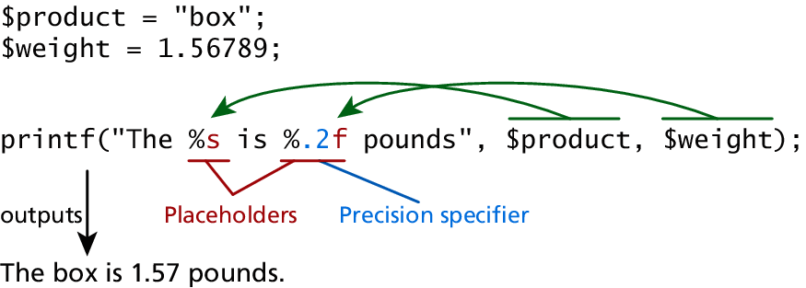
PrintF
As an alternative, you can use the printf() function.
derived from the same-named function in the C programming language
takes at least one parameter, which is a string, and that string optionally references parameters, which are then integrated into the first string by placeholder substitution
Can also apply special formatting, for instance, specific date/time formats or number of decimal places
b for binary
d for signed integer
f for float
o for octal
x for hexadecimal

Slide 25
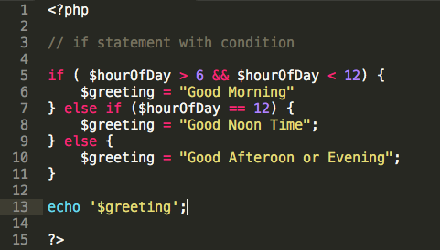
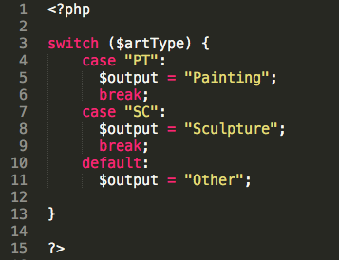
Conditional Statements / Switch

Slide 26
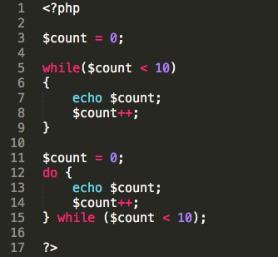
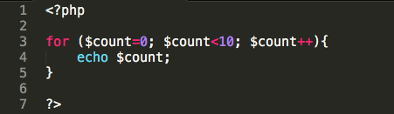
Loops

Slide 27
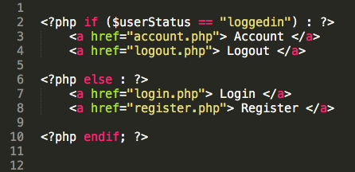
Alternate syntax for Control Structures
PHP has an alternative syntax for most of its control structures. In this alternate syntax
the colon (:) replaces the opening curly bracket,
while the closing brace is replaced with endif;, endwhile;, endfor;, endforeach;, or endswitch;

Slide 28
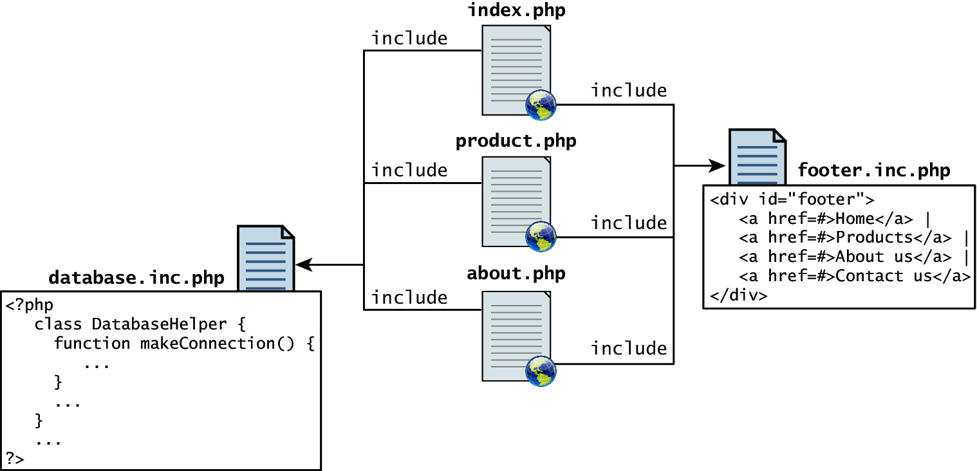
Include Files
PHP has the ability to include or insert content from one file into another.
PHP provides four different statements for including files, as shown below.
include "somefile.php";
include_once "somefile.php";
require "somefile.php";
require_once "somefile.php";
Only difference between include and require is the “require” handles error conditions.
Notes:
Include files are the equivalent of copying and pasting.
Variables defined within an include file will have the scope of the line on which the include occurs
Any variables available at that line in the calling file will be available within the called file
If the include occurs inside a function, then all of the code contained in the called file will behave as though it had been defined inside that function

Slide 29
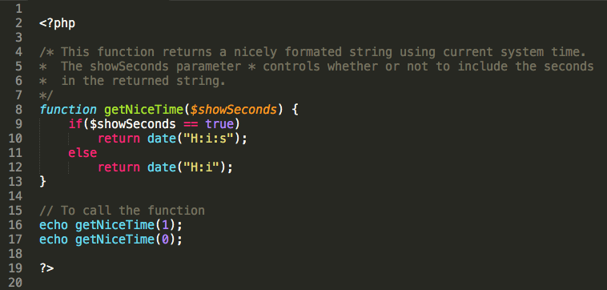
Functions
Just as with any language, you can package reusable code as a function.

Slide 30
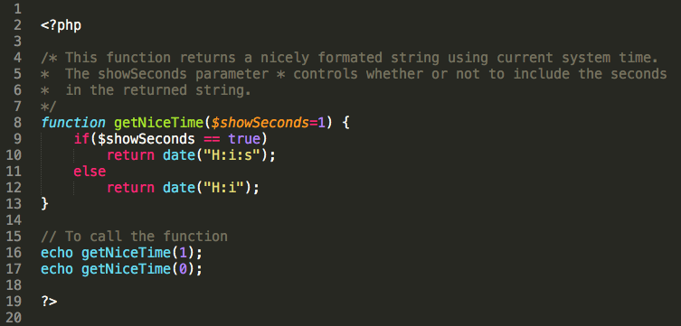
Parameter Default Values
Now if you were to call the function with no values, the $showSeconds parameter would take on the default value, which we have set to 1, and return the string with seconds.

Slide 31
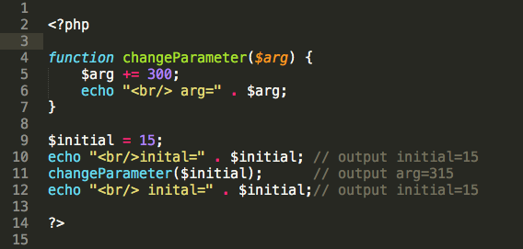
Pass Parameters by Value
By default, arguments passed to functions are passed by value in PHP.
This means that PHP passes a copy of the variable so if the parameter is modified within the function, it does not change the original.

Slide 32
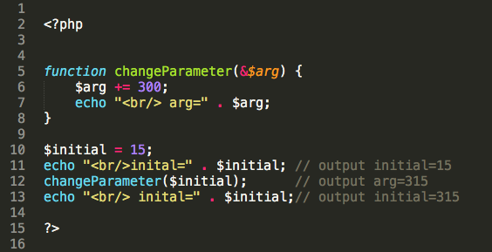
Pass Parameters by Reference
PHP also allows arguments to functions to be passed by reference, which will allow a function to change the contents of a passed variable.
Add ampersand (&) symbol next to the parameter name in the function declaration

Slide 33
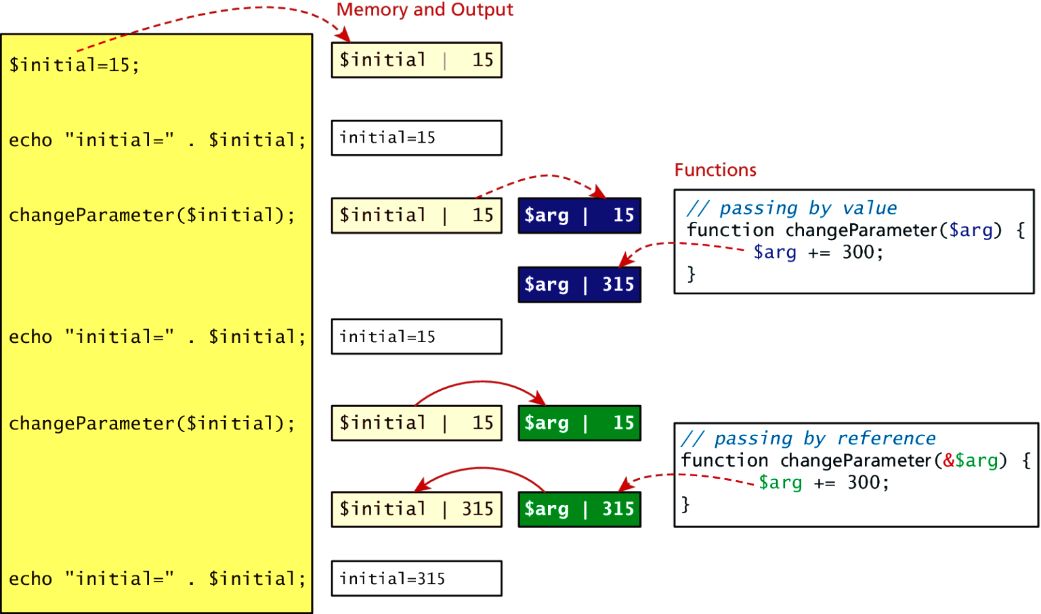
Value vs Reference

Slide 34
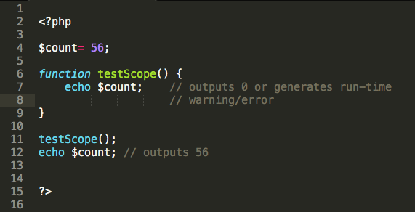
Variable Scope in functions
All variables defined within a function (such as parameter variables) have function scope, meaning that they are only accessible within the function.
Any variables created outside of the function in the main script are unavailable within a function.

Slide 35
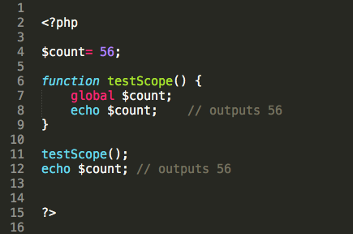
Global variables
Variables defined in the main script are said to have global scope.
Unlike in other programming languages, a global variable is not, by default, available within functions.
PHP does allow variables with global scope to be accessed within a function using the global keyword
Use global keyword to refer to a global variable.

Slide 36
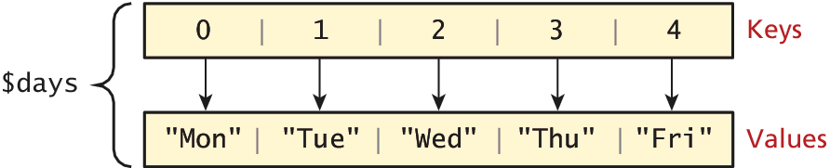
Arrays
In PHP an array is actually an ordered map, which associates each value in the array with a key.
In most programming languages array keys are limited to integers, start at 0, and go up by 1.
In PHP, array keys must be either integers or strings and need not be sequential.
Don’t mix key types i.e. “1” vs 1
If you don’t explicitly define them they are 0,1,…

Slide 37
Arrays
The following declares an empty array named days:
You can also initialize it with a comma-delimited list of values inside the ( ) braces using either of two following syntaxes:
$days = array();
$days = array( "Mon” , "Tue” , "Wed” , "Thu” , "Fri” );
$days = [ "Mon” , "Tue” , "Wed” , "Thu” , "Fri” ]; // alternate

Slide 38
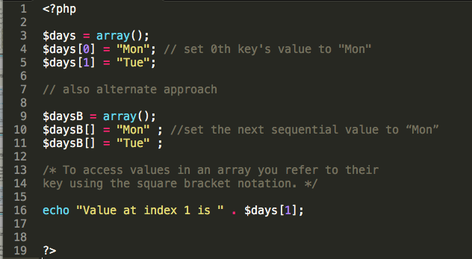
Arrays
You can also declare each subsequent element in the array individually:
Add element to index 0
A new element can be added to the end of any array

Slide 39
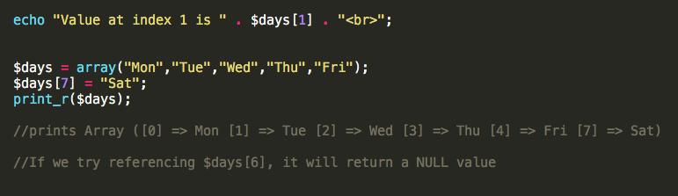
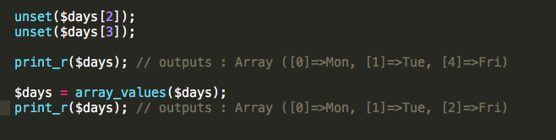
Arrays (Cont.)
PHP is more than happy to let you “skip” an index.
It will set skipped value to NULL
You can explicitly delete array elements using the unset() function
array_values() reindexes the array numerically

Slide 40
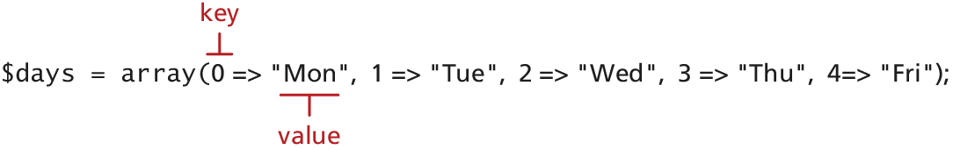
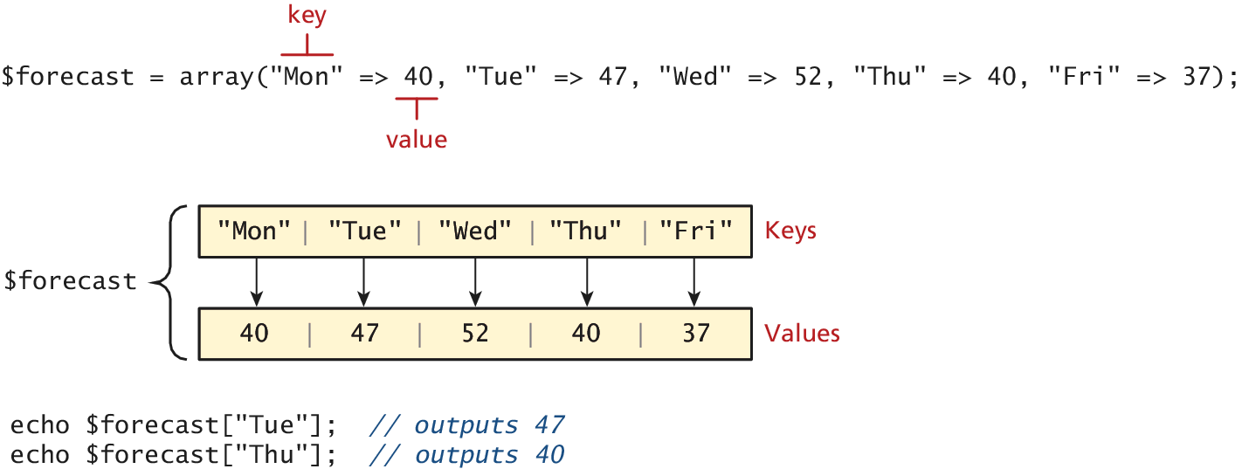
Keys and Values
In PHP, you are also able to explicitly define the keys in addition to the values.

Slide 41
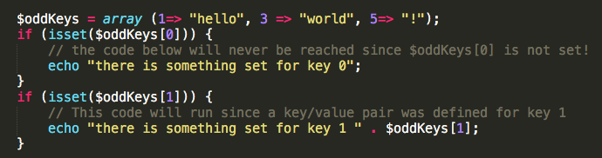
Checking for a value in the array
Since array keys need not be sequential, and need not be integers, you may run into a scenario where you want to check if a value has been set for a particular key.
To check if a value exists for a key, you can therefore use the isset() function, which returns true if a value has been set, and false otherwise

Slide 42
Array operations
sort($someArray)
asort($someArray)
array_keys($someArray)
array_values($someArray)
array_rand($someArray, $num=1)
array_reverse($someArray)
array_walk($someArray, $callback, optionalParam)
in_array($needle, $haystack)
shuffle($someArray

Slide 43
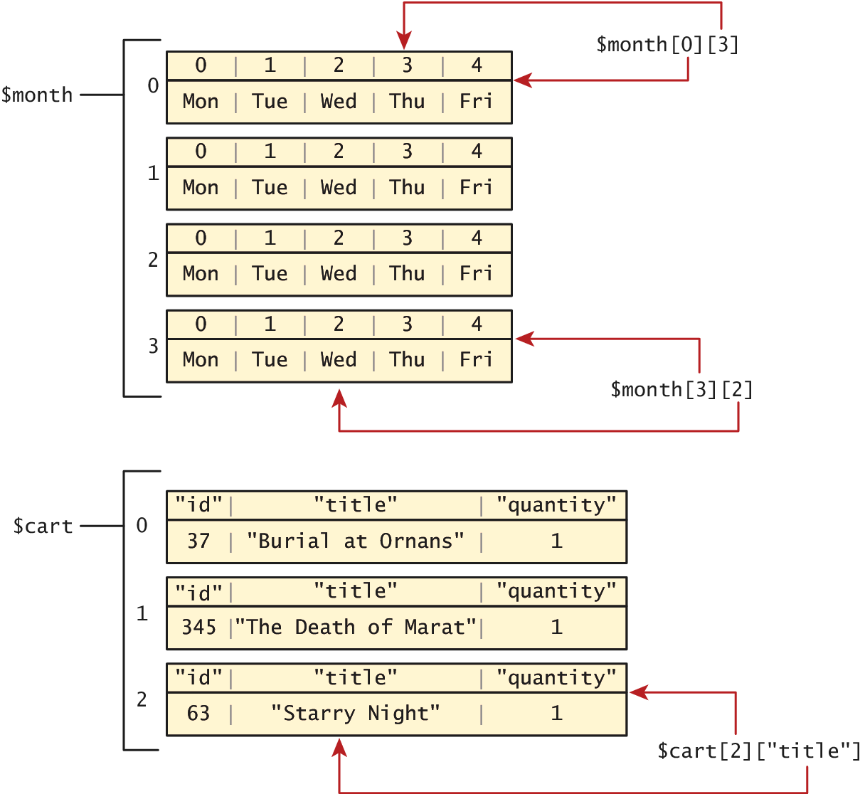
Multidimensional Arrays
$month = array(
array( "Mon” , "Tue” , "Wed” , "Thu” , "Fri” ),
array( "Mon” , "Tue” , "Wed” , "Thu” , "Fri” ),
array( "Mon” , "Tue” , "Wed” , "Thu” , "Fri” ),
array( "Mon” , "Tue” , "Wed” , "Thu” , "Fri” )
);
echo $month[0][3]; // outputs Thu

Slide 44
Multidimensional Arrays
$cart = array();
$cart[] = array("id" => 37, "title" => "Burial at Ornans", "quantity" => 1);
$cart[] = array("id" => 345, "title" => "The Death of Marat", "quantity" => 1);
$cart[] = array("id" => 63, "title" => "Starry Night", "quantity" => 1);

Slide 45
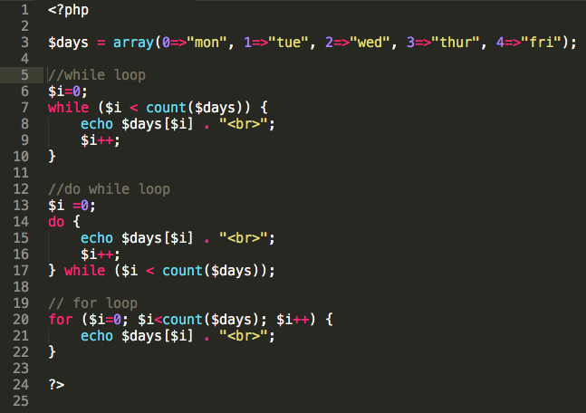
Iterating through an array
In this example, the array uses integers as keys, so we can use the variable $i to index array elements and increment $i to iterate through the array.
But, what if the array keys are not integers?

Slide 46
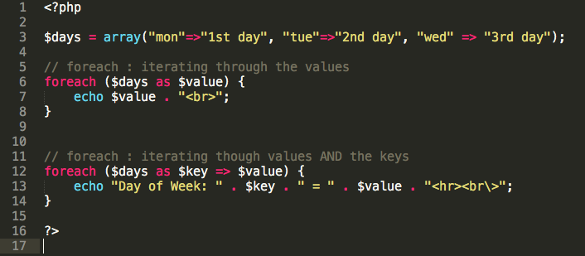
Iterating through an array (Cont.)
If the array keys are non-sequential integers, then we need to use an iterator to loop through an array.

Slide 47
Superglobal Arrays
PHP uses special predefined arrays called superglobal variables that allow the programmer to easily access HTTP headers, query string parameters, and other commonly needed information.
They are called superglobal because they are always in scope, and always defined.
The $_GET and $_POST arrays are the most important superglobal variables in PHP since they allow the programmer to access data sent by the client in a query string.
Lets see an example on the next slide

Slide 48
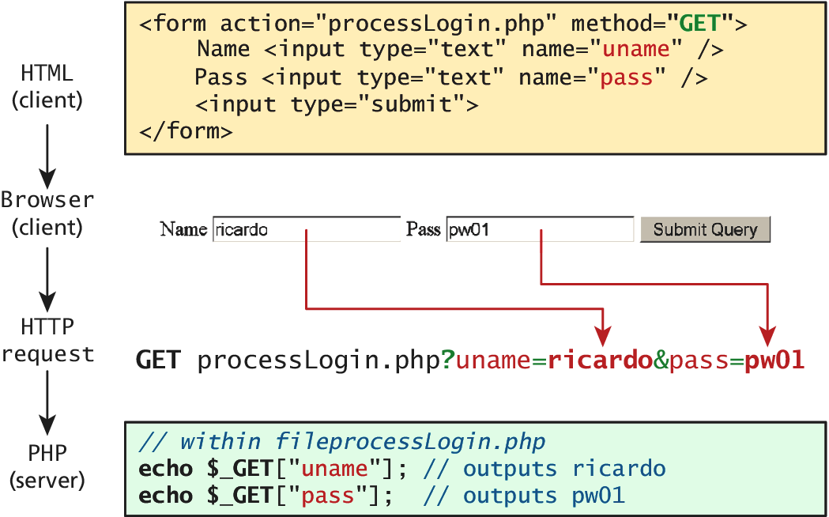
$_GET and $_POST
Get requests parse query strings into the $_GET array
Post requests are parsed into the $POST array
This mechanism greatly simplifies accessing the data posted by the user, since you need not parse the query string or the POST request headers!

Slide 49
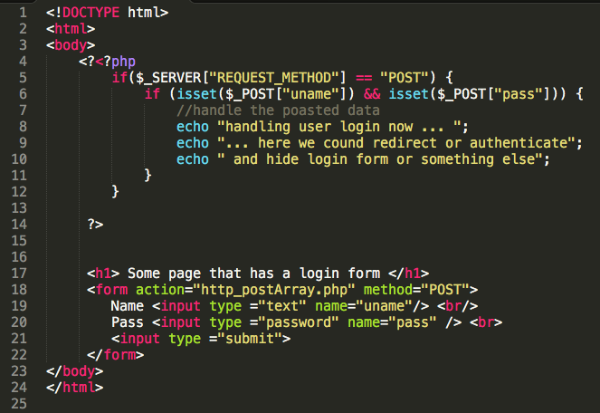
Form Example

Slide 50
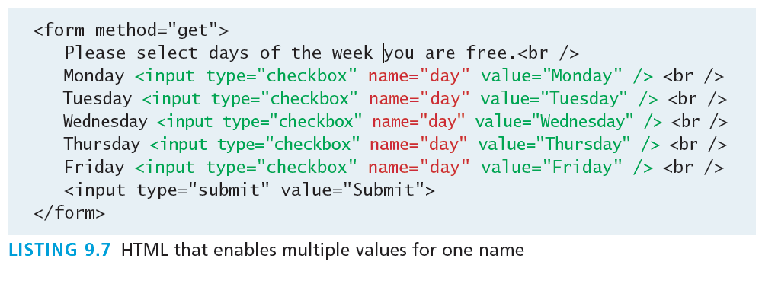
Accessing Form Array Data
Sometimes in HTML forms you might have multiple values associated with a single name;

Slide 51
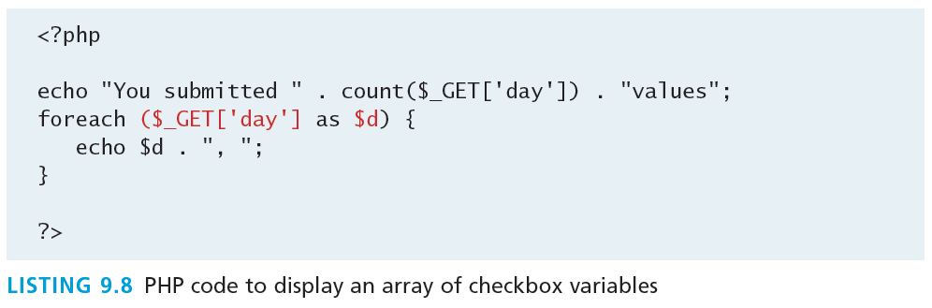
Accessing Form Array Data
Unfortunately, if the user selects more than one day and submits the form, the $_GET['day'] value in the superglobal array will only contain the last value from the list that was selected.
To overcome this limitation, you must change the name attribute for each checkbox from day to day[].
Monday <input type="checkbox" name="day[]" value="Monday" />
Tuesday <input type="checkbox" name="day[]" value="Tuesday" />
After making this change in the HTML, the corresponding variable $_GET['day'] will now have a value that is of type array.

Slide 52
Overview
PHP is a full-fledged object-oriented language with many of the syntactic constructs popularized in languages like Java and C++.
Earlier versions of PHP do not support all of these object-oriented features (use 5.0 + to avoid issues).

Slide 53
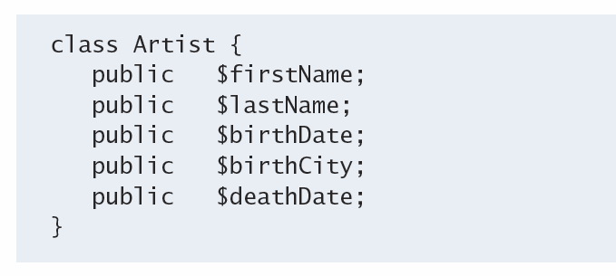
Defining Classes
The PHP syntax for defining a class uses the class keyword followed by the class name and { } braces
Defining a class is not the same as using it. To make use of a class, one must instantiate (create) objects from its definition using the new keyword.
$picasso = new Artist();
$dali = new Artist();

Slide 54
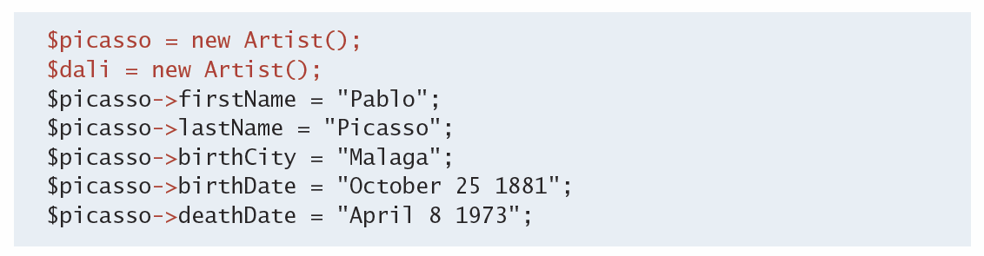
Properties
Once you have instances of an object, you can access and modify the properties of each one separately using the variable name and an arrow (->).

Slide 55
Constructors
Constructors let you specify parameters during instantiation to initialize the properties within a class right away.
In PHP, constructors are defined as functions (as you shall see, all methods use the function keyword) with the name __construct().
Notice that in the constructor each parameter is assigned to an internal class variable using the $this-> syntax. you must always use the $this syntax to reference all properties and methods associated with this particular instance of a class.

Slide 56
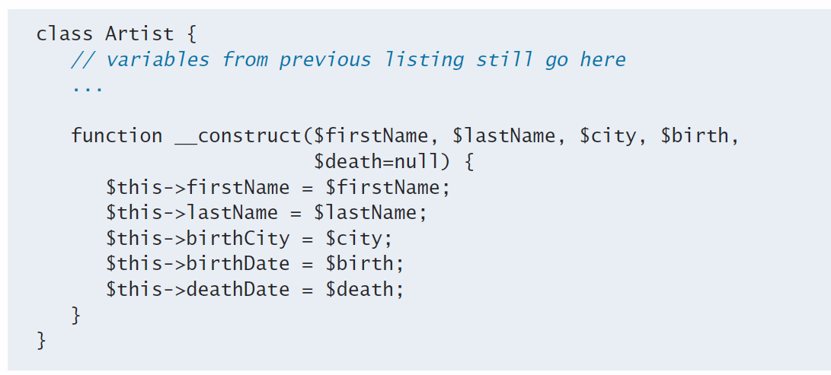
Constructors
$picasso = new Artist("Pablo","Picasso","Malaga","Oct 25,1881","Apr 8,1973");
$dali = new Artist("Salvador","Dali","Figures","May 11 1904", "Jan 23 1989");

Slide 57
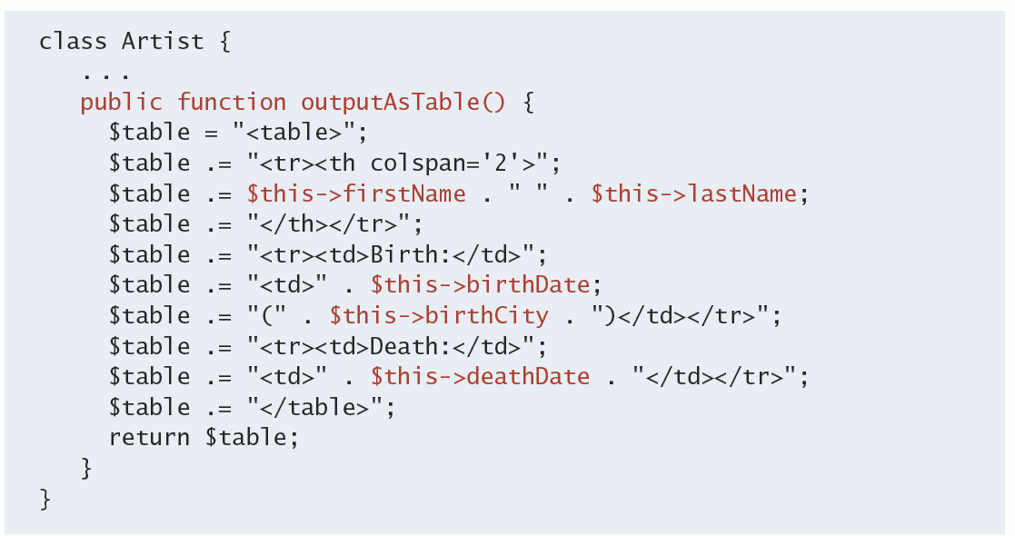
Methods
Methods and are like functions, except they are associated with a class.
// usage
$picasso = new Artist( . . . )
echo $picasso->outputAsTable();

Slide 58
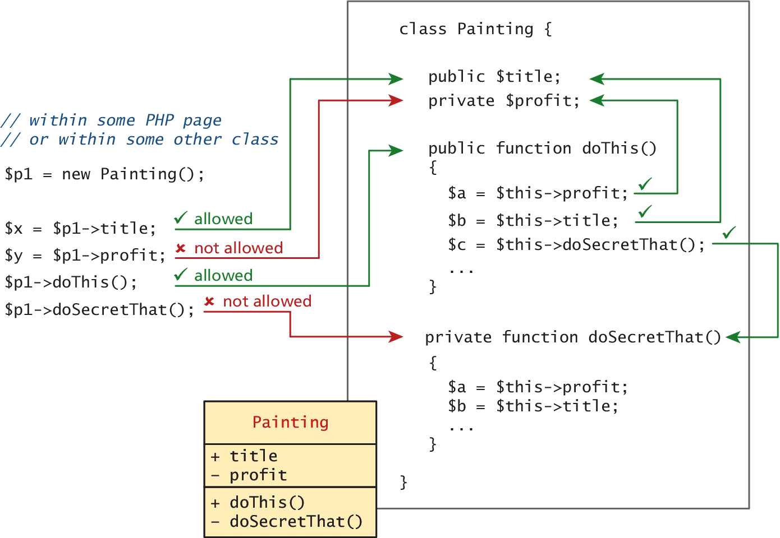
Visibility
The visibility of a property or method determines the accessibility of a class member and can be set to:
Public the property or method is accessible to any code that has a reference to the object
Private sets a method or variable to only be accessible from within the class
Protected is related to inheritance…

Slide 59
Static Members
A static member is a property or method that all instances of a class share.
Unlike an instance property, where each object gets its own value for that property, there is only one value for a class’s static property.
Static members use the self:: syntax and are not associated with one object
They can be accessed without any instance of an Artist object by using the class name, that is, via Artist::$artistCount.

Slide 60
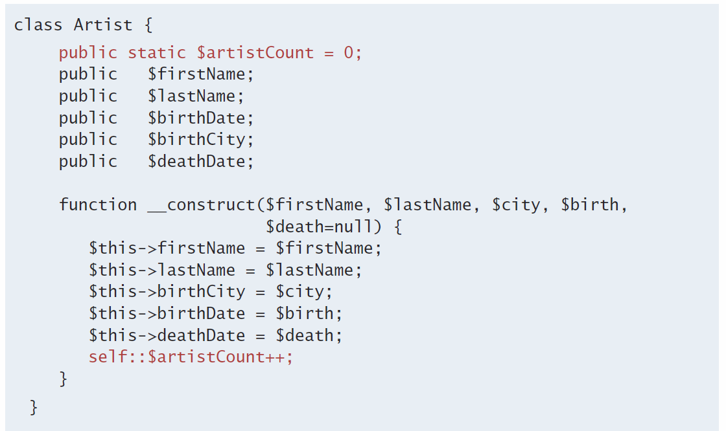
Static Members

Slide 61
Class constants
They are added to a class using the const keyword.
Unlike all other variables, constants don’t use the $ symbol when declaring or using them.
Accessed both inside and outside the class using
const EARLIEST_DATE = 'January 1, 1200’ ;
self::EARLIEST_DATE // in the class and
classReference::EARLIEST_DATE // outside.

Slide 62
Data Encapsulation
Perhaps the most important advantage to object-oriented design is the possibility of encapsulation, which generally refers to restricting access to an object’s internal components.
Another way of understanding encapsulation is: it is the hiding of an object’s implementation details.
A properly encapsulated class will define an interface to the world in the form of its public methods, and leave its data, that is, its properties, hidden (that is, private).

Slide 63
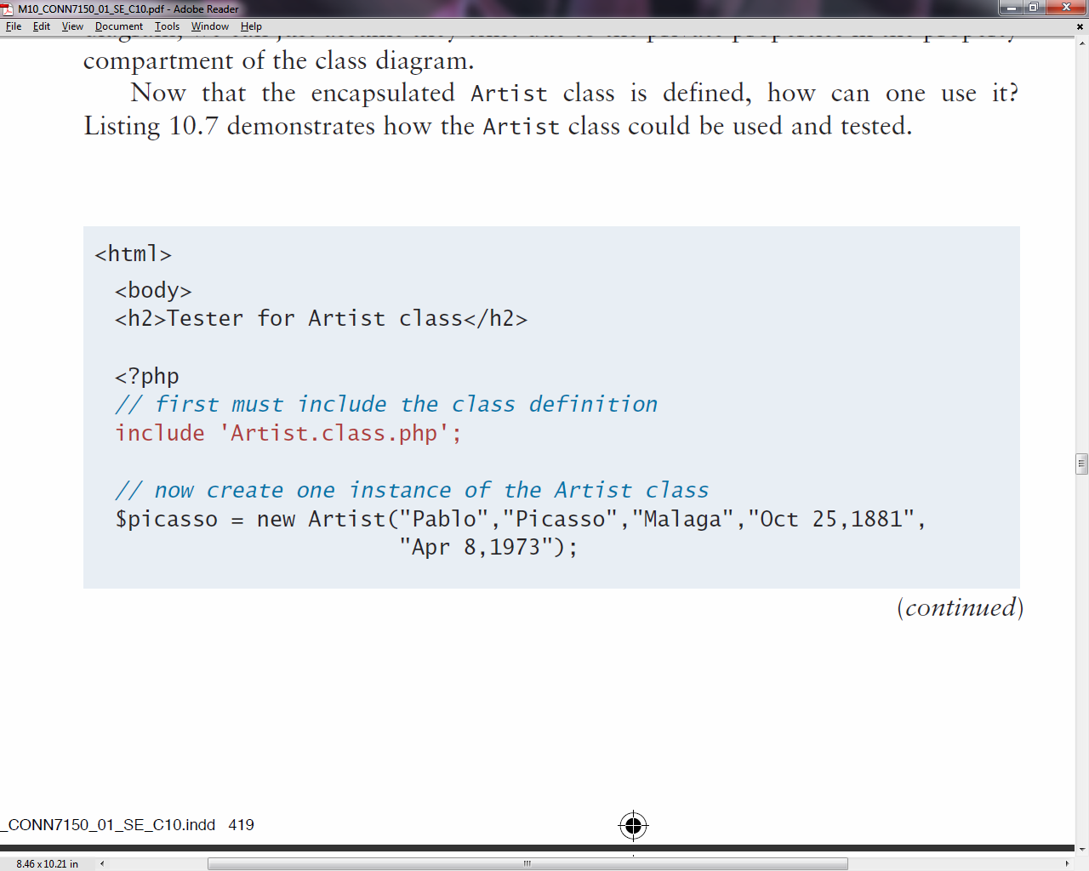
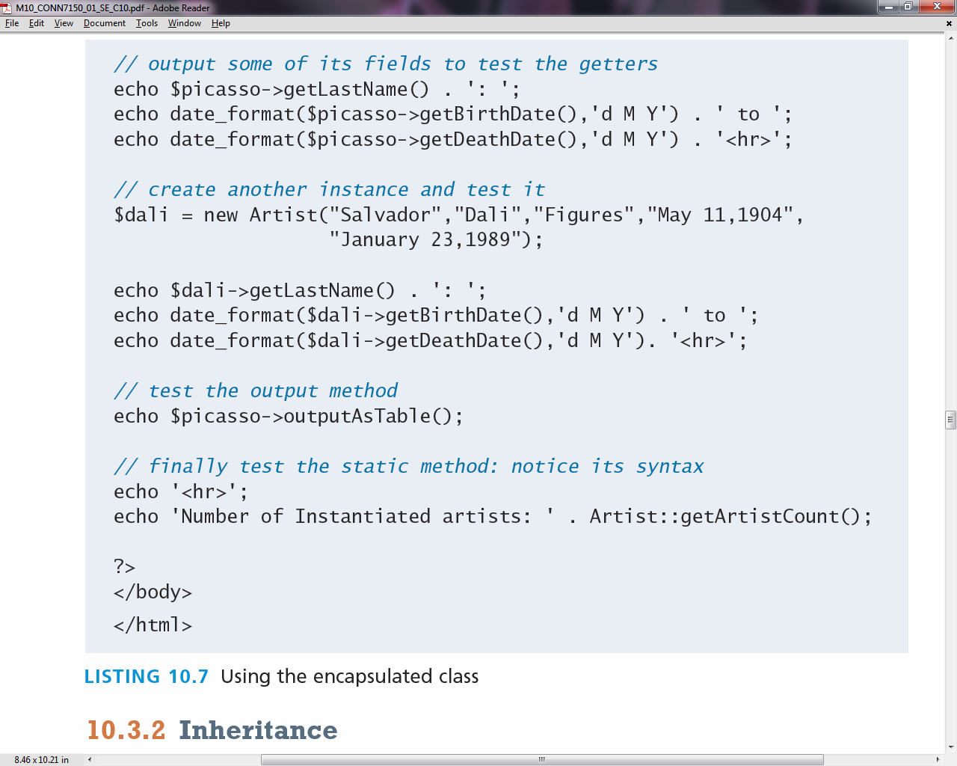
Data Encapsulation

Slide 64
Inheritance
Inheritance enables you to create new PHP classes that reuse, extend, and modify the behavior that is defined in another PHP class.
PHP only allows you to inherit from one class at a time
A class that is inheriting from another class is said to be a subclass or a derived class
The class that is being inherited from is typically called a superclass or a base class
A PHP class is defined as a subclass by using the extends keyword.
class Painting extends Art { . . . }

Slide 65
Polymorphism
Polymorphism is the notion that an object can in fact be multiple things at the same time.
Consider an instance of a Painting object named $guernica created as follows:
$guernica = new Painting("1937",$picasso,"Guernica","Oil on canvas");
The variable $guernica is both a Painting object and an Art object due to its inheritance.
The advantage of polymorphism is that we can manage a list of Art objects, and call the same overridden method on each.

Slide 66
Interfaces
An object interface is a way of defining a formal list of methods that a class must implement without specifying their implementation.
Interfaces are defined using the interface keyword, and look similar to standard PHP classes, except an interface contains no properties and its methods do not have method bodies defined.
In PHP, a class can be said to implement an interface, using the implements keyword:
class Painting extends Art implements Viewable { ... }

Slide 67

Interface Example

